Slide 1


Introduction to V+

Slide 2
Agenda
Introductory V+
Introduction into V+ (Section 1)
V+ Exercise 1 (Section 2)
Intermediate V+ (Section 3)
V+ Exercise 2 (Section 4)
Miscellaneous Devices (Section 5)
Questions and Answers (Section 6)

Slide 3
Introductory V+

Slide 4
Introduction to V+
Form Basic Understanding of V+
Intermediate V+
Advanced V+

Slide 5
Why Was V+ Developed
Ease of Concept Design
High Cost of Application Design
Maximize Software Reuse
Self Documenting

Slide 6
Generations of Programming Methods
1st Machine Code
  01000101
2nd Assembly Language
  MOV al,bx
3rd High Level Language
  a=a+b+s;

Slide 7
Generations of Programming Methods
4th OOP Programming
  Class furniture;
  Derived class chair;
Visual C++
  C++ is NOT a visual language

Slide 8
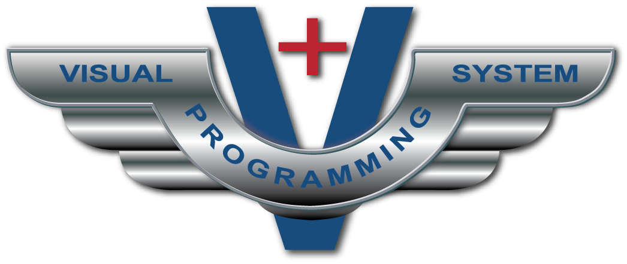
Generations of Programming Methods
5th Visual Language

Slide 9
Various Types of Visual Languages
Data Flow
State Transition
Object Oriented Nyquist
  V+ is a data flow visual language

Slide 10
Traditional Software Lifecycle
Requirement
Analysis
Not Necessary
with V+
Design
Implementation
(Code)
Test
Final
Product

Slide 11
Software Design
Top Level
  (Configuration)
Detailed
  (V+ designs)

Slide 12
Software Top Level Design
Analog In/Out Channels
Wave In/Out Channels
Interfaces
Configurations
  Drivers
  Execution rate
  Networked audio

Slide 13
V+ is Similar to Schematic Diagrams
In fact, V+ is a schematic of the software architecture, execution order, etc.
V+ is self documenting since the worksheet is the source.

Slide 14
V+ is Not a Code Generator
V+ objects are pre-compiled software modules that can be authored in any language supporting COM.
Currently, objects are authored by VPLus Corporation only.

Slide 15
Introduction into V+
(Section 1)

Slide 16
Introduction to V+
Windows XP (Service Pack 3)
  Windows firewall turned off
32 Bit Code
COM, COM+, and .NET Based

Slide 17
Introduction to V+
A visual program, called a design, is constructed of objects and ports connected via nets and placed on one or more worksheets.

Slide 18
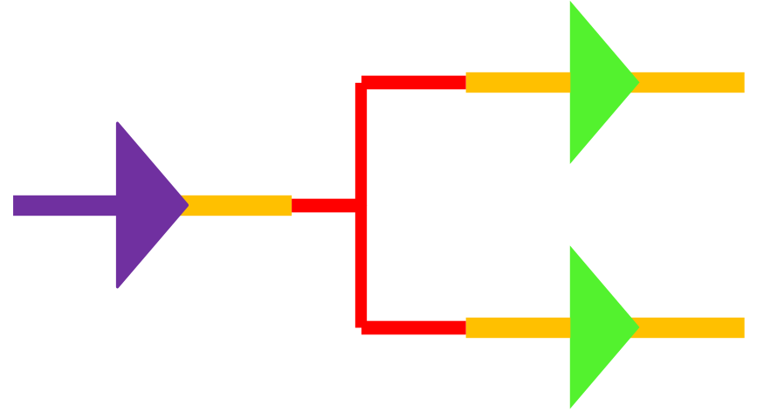
V+ is a Data Flow Visual Language
Data travels via nets from object outputs pins to object input pins.

Slide 19

Object Data Flow
Inside objects, data flows from object input pins to object output pins.

Slide 20
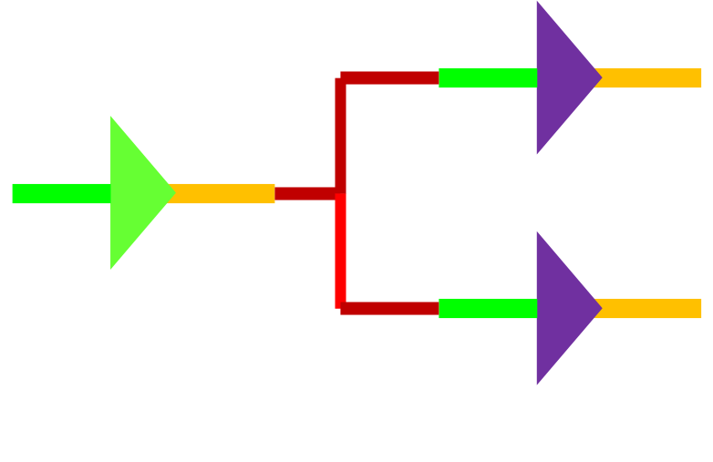
Object Execution Order
Execution order is defined by the user and defaults to an order of placement on the worksheet.

Slide 21

Objects
Objects Are Execution Units
  Constructor
  Pre Execute
  Execute
  Post Execute
  Destructor
Design Must Have at Least Two Objects
Simple to Complex

Slide 22
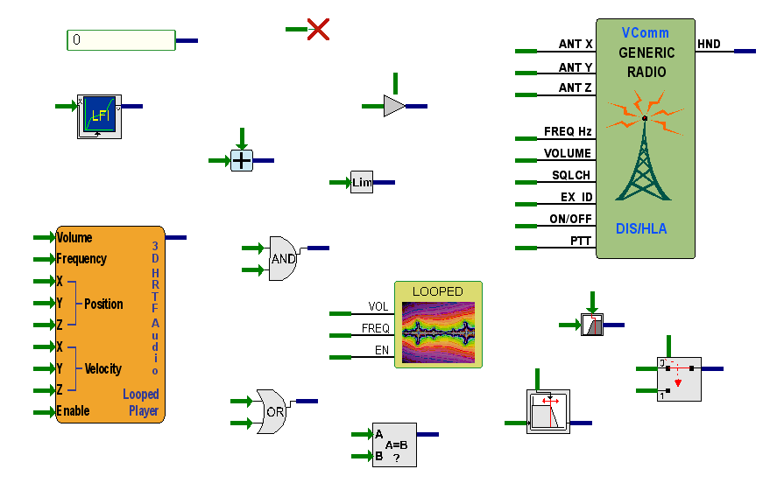
Examples of V+ Objects

Slide 23
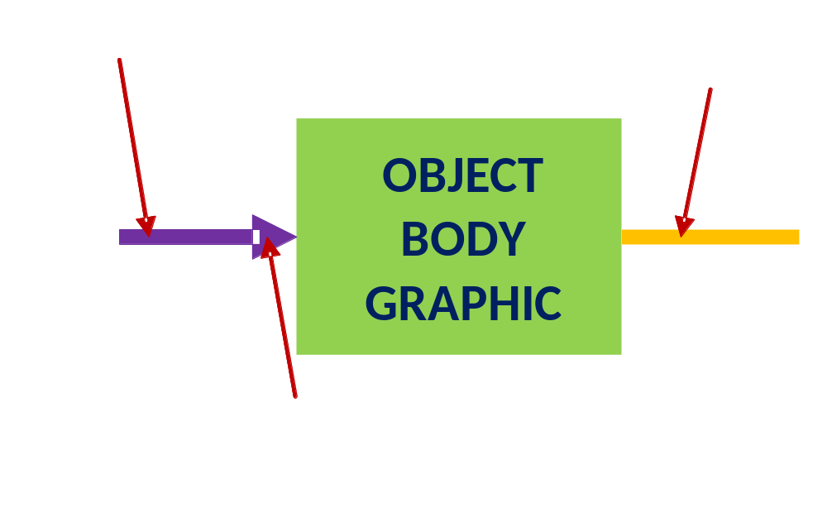
Object Anatomy

Slide 24
Objects – Static Data
User Editable Initialized Constants
Any Object May Contain Static Data
Standard Static Data Types
  Float, string, table
Activated by Double-Click

Slide 25
Ports
Connections To/From the Outside
Ports are Grouped into I/O Devices
I/O Devices are Grouped into Drivers

Slide 26
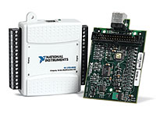
Ports
PORT 0
PORT 1
I/O Driver
I/O Devices
PORT n
Ports

Slide 27
V+ I/O Driver Example
I/O Driver – UDP/ IP Ethernet
Contains the Following Devices:
  I/O Device – Input
    Ports
      Ports 1,2,3,4, etc.

Slide 28
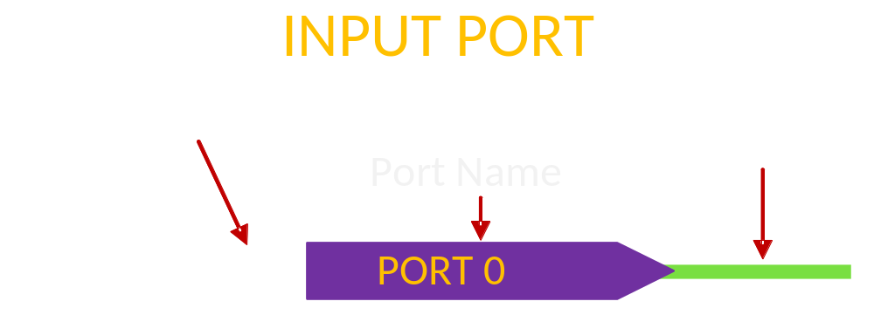
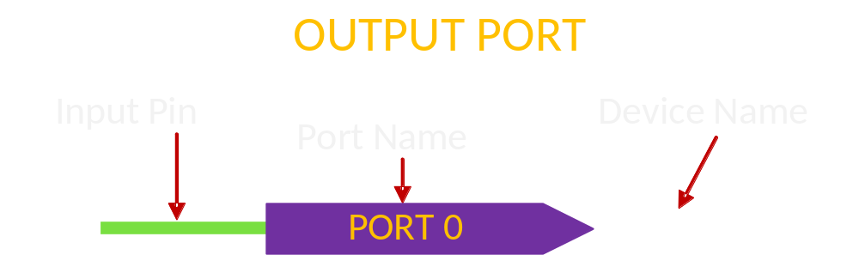
Port Anatomy

Slide 29
V+ I/O Drivers
V+ Shipped with Basic Drivers
  Configurable network socket
  Ethernet UPD/IP
  File mapping I/O device
  Joystick input device
Windows Audio Mix

Slide 30
Nets
Connects Object Pins
Contains 32-Bit Float Data
Output to Input
Cannot “Short” Inputs

Slide 31
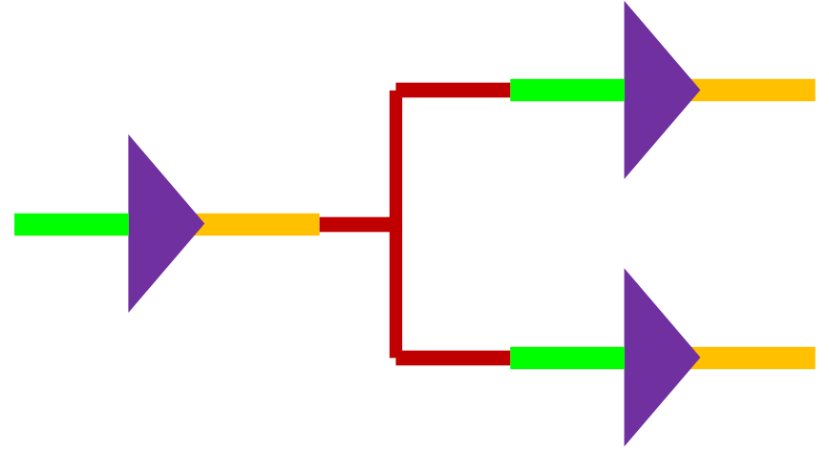
Nets
Single Output to Multiple Inputs

Slide 32
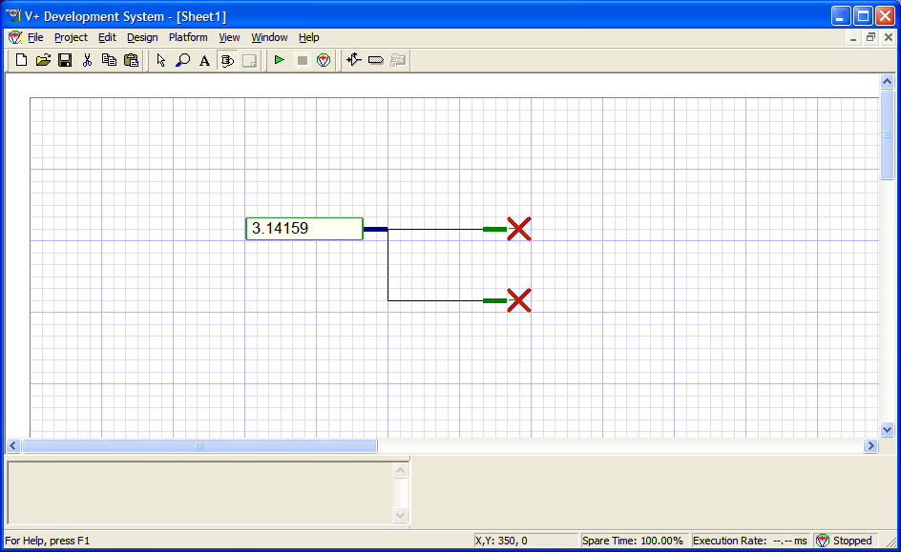
Nets

Slide 33
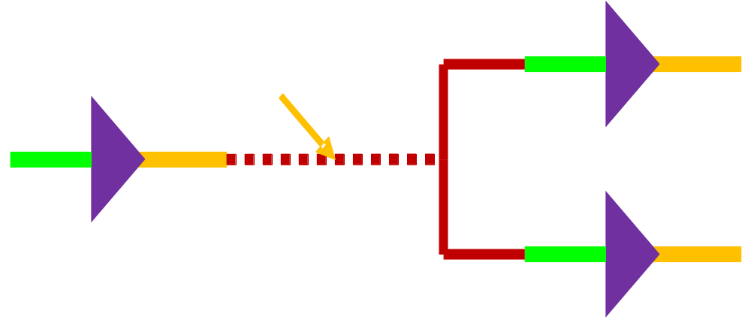
Nets

Slide 34
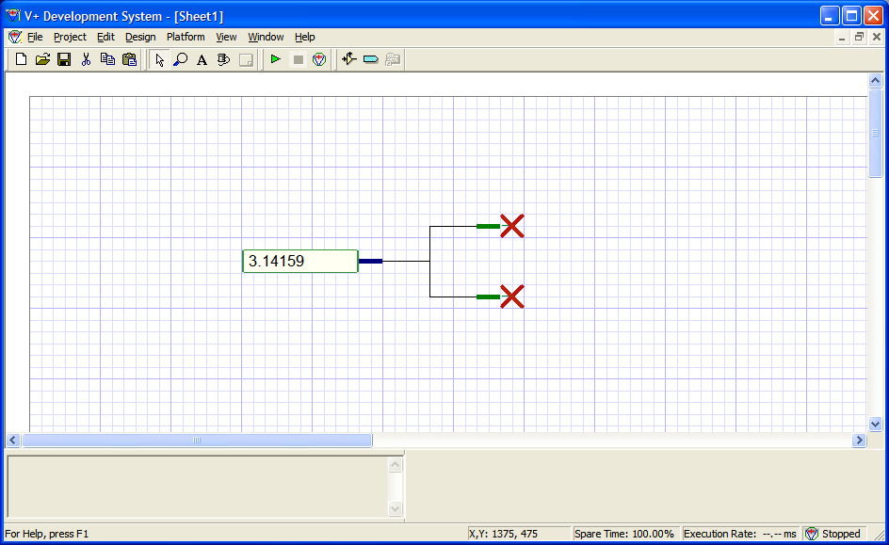
Nets

Slide 35
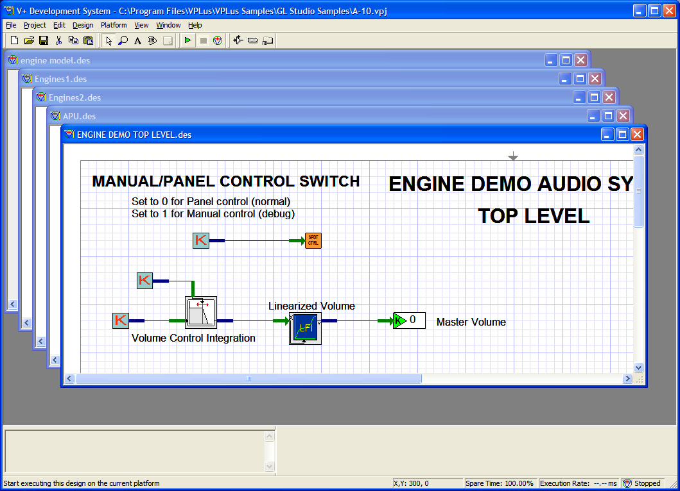
Worksheets

Slide 36
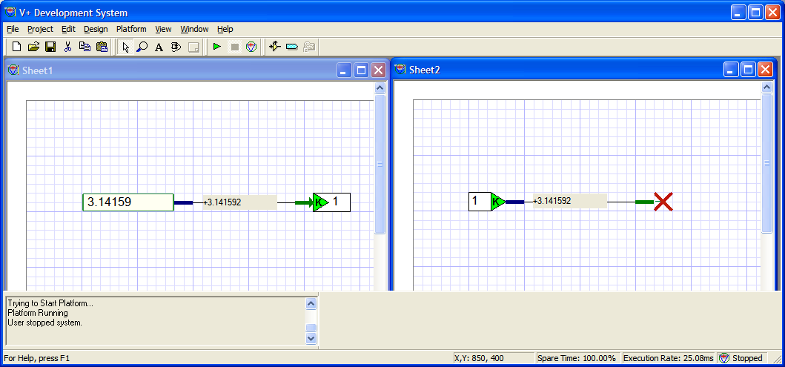
Worksheets
Sharing data among worksheets is
accomplished via worksheet connectors.

Slide 37
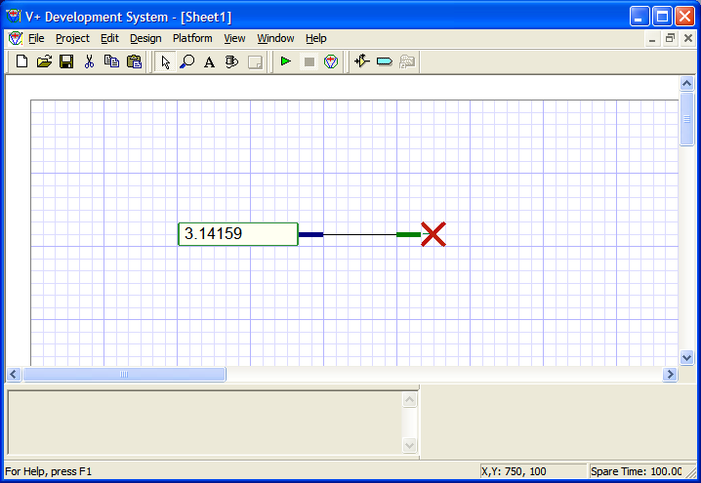
The Simplest of Designs

Slide 38
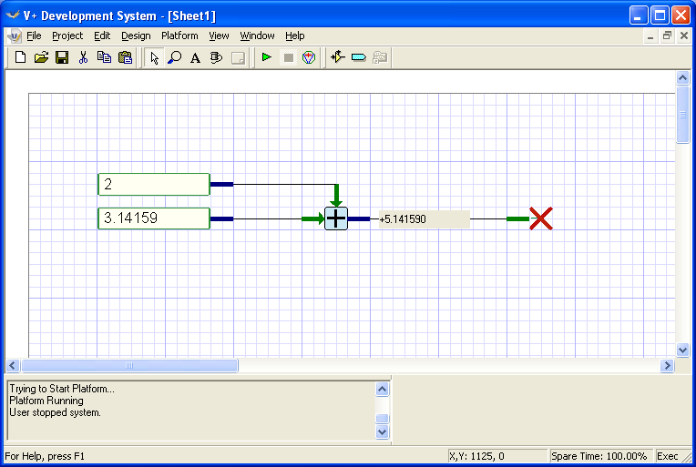
A Simple Math Design

Slide 39
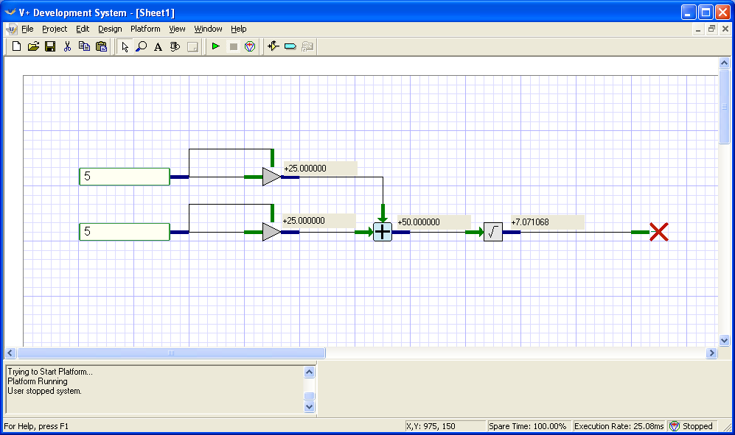
Pythagorean Theorem
(Distance Calculation)
c = √a² + b²
a
b
c

Slide 40
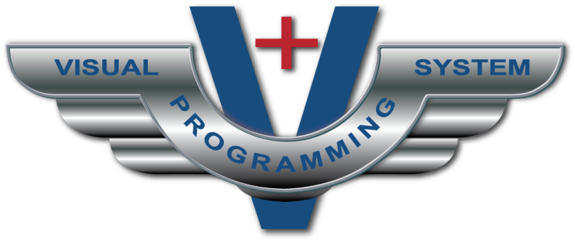
V+ Classroom Exercise 1
(Section 2)

Slide 41
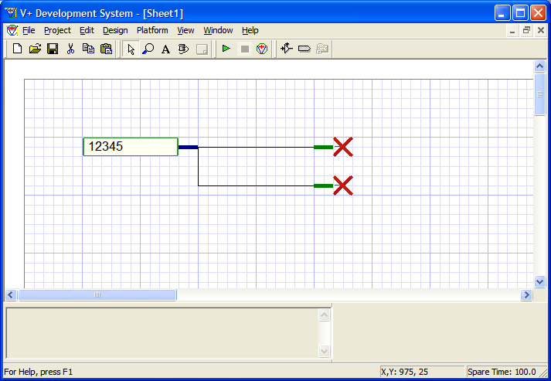
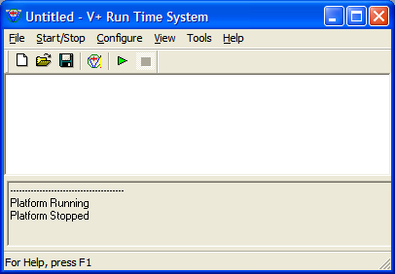
Development and Run-time Systems
Development System
Run-time System

Slide 42
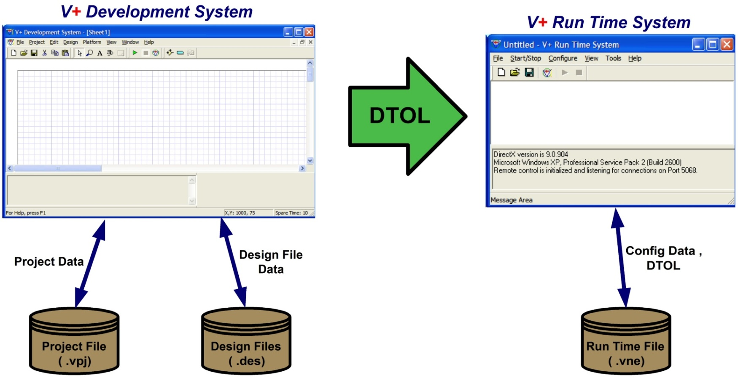
Design Process

Slide 43
File Types
.
.DES - Design File Worksheet
.VPJ - Contains Multiple Worksheets
.VNE - Run-time Configuration and Executable

Slide 44
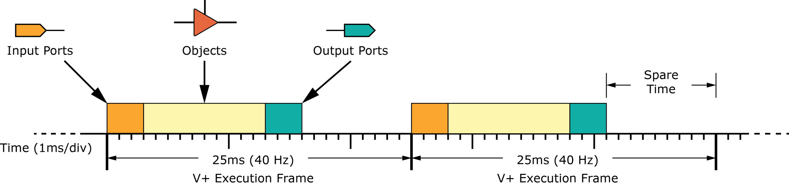
V+ Execution
V+ is a data flow language
Frame based: Input ports, objects then output ports
Data flows from input (blue pins) to output (green pins)

Slide 45
V+ Execution Order Within a Frame
Input Ports
Output Ports
n
1 2 3
Objects 1 Through n

Slide 46
Spare Time
Run-time Calculates Spare Time Per Frame
Measured with Special High-Resolution Timer Accurate to System Clock Resolution

Slide 47
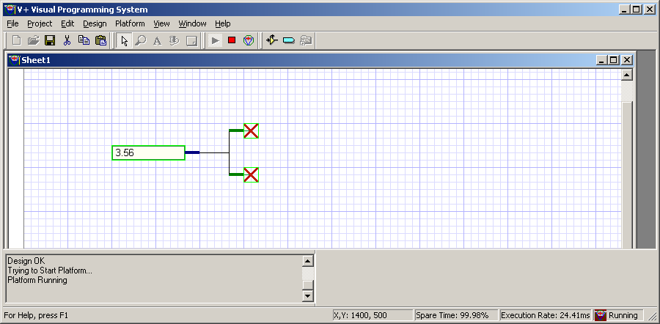
Spare Time

Slide 48
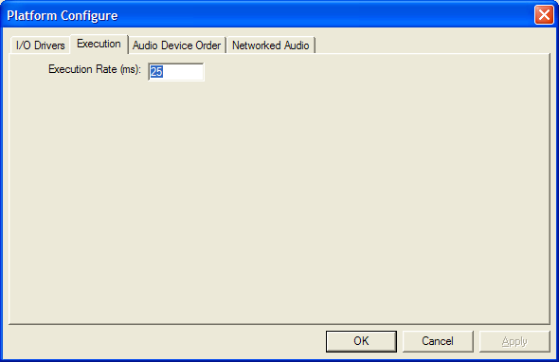
V+ Execution Rate

Slide 49
V+ Execution Rate
Default of 25ms (40Hz)
  From .01 Hz
  Up to 1,000 Hz
    Future systems… even faster

Slide 50
Development and Run-time Systems
Development System
  Used to edit design
  Not needed for final system
  Costs more
Run-time System
  Always required
  Provides object inventory
  I/O device configuration
  System configuration
  Execution

Slide 51
Application Process Flow
1. Analyze Requirements
2. Define Interfaces
3. Configure Platform (.vne file)
4. Create Worksheets (.des files)
5. Organize into Project (.vpj file)
6. Run and Debug System
7. Save in Platform (.vne file)

Slide 52

Intermediate V+
(Section 3)

Slide 53
Why Separate Development and Run-time Systems?
Editor is a Much Larger Application
Not Needed for Execution Environment
Editor Costs More
Quantity Systems Can use Run-time System

Slide 54
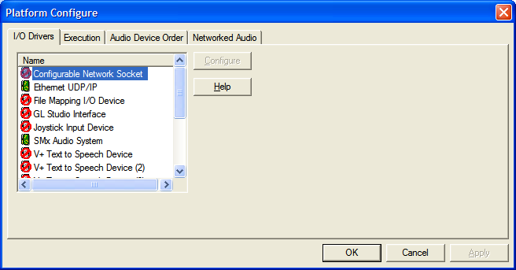
Run-time System Configuration

Slide 55
Run-time System Configuration
I/O Driver Configuration
Execution Rate
Audio Device Order
Networked Audio Configuration
  (DIS and HLA)

Slide 56
I/O Driver Configuration

Slide 57
I/O Driver Configuration
Most Drivers are Installed Separately
Each Driver has Its Own Configuration User Interface

Slide 58
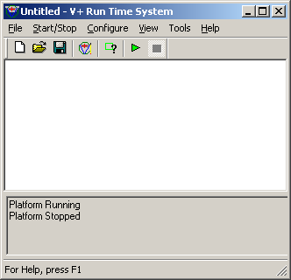
Configuration is Saved in .VNE File
CONFIG
.VNE File

Slide 59
V+ Development System
User Enters/Edits a Design
2. User Presses the Play Button
V+ Editor Checks for Visual Errors
Error Messages Printed to Editor Message Window

Slide 60
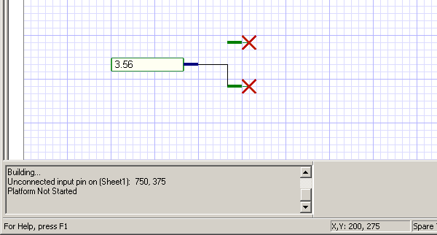
Open Pin Error

Slide 61
V+ Development System
Once All Errors Are Cleared:
  V+ submits design to the Run-time System
When the Design is Submitted, the Following Message Appears:
  “Trying to Start Platform”

Slide 62
Design Time Object List (DTOL)
The Run-time System then begins the process of trying to run the DTOL.

Slide 63
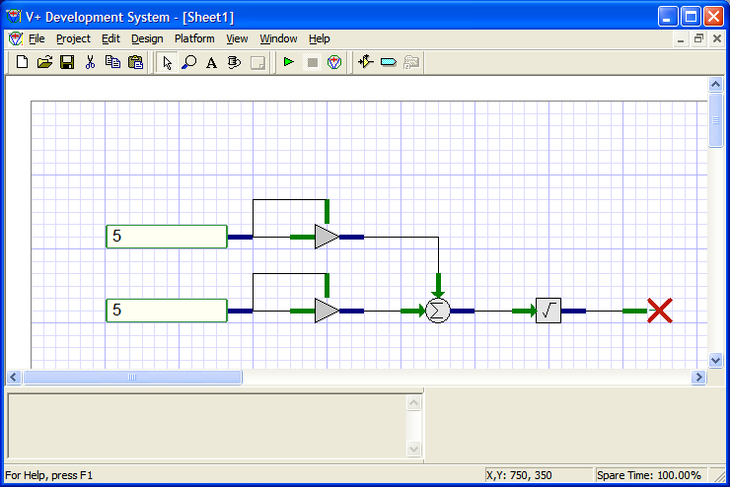
DTOL Submission
DTOL

Slide 64
Run-time System
Accepts DTOL From Editor
Verifies Objects Are In Inventory
Verifies Ports Are In Inventory
Tries To Start Objects and Devices

Slide 65
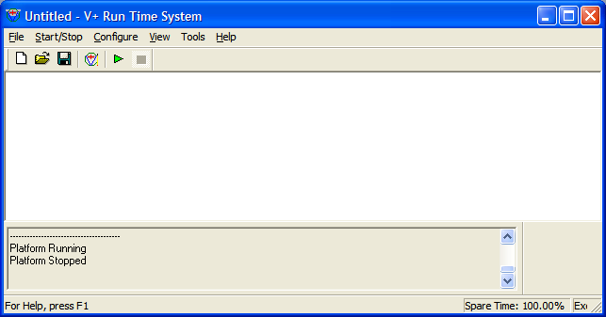
Run-time System Message Window
Scrollable message area

Slide 66
Run-time System
Pre-Execute Phase
Each Device and Object May Halt Pre-Execution
  Most will display an error in the message window.
Once All Objects and Devices Report They Can Start:
  The DTOL is executed.

Slide 67
Run-time System
Post-Execute Phase
Each Device and Object is Asked to Stop During User Stop Commands
Once All Objects and Devices Report They Can Stop:
  The DTOL execution is halted
  Again, read your message window

Slide 68
.VNE File DTOL and Configuration
Configuration is always saved with .VNE file.
DTOL is only saved if a successful execution has occurred.

Slide 69
Configuration is Saved in .VNE File
CONFIG
DTOL
.VNE File

Slide 70
.VNE File – Updating
Anytime the design or configuration has changed, the .VNE file must be resaved.
The .VNE file is similar to an .EXE file in this sense.

Slide 71
.VNE Files – Auto-booting
The .VNE File May Be Executed Directly:
Insert the .VNE file into the STARTUP folder for auto-loading the system at power-up.
Double-clicking the .VNE file will start the Run-time System and execute the design – provided that is present in the file.

Slide 72

V+ Classroom Exercise 2
(Section 4)

Slide 73
Remote Control Applications
Two Types of Remote Controls:
  User control of V+ via remote pc
  Programmatic control via host
Useful for Tuning Sounds
Versatility of Different Configurations

Slide 74
User Control – Windows XP
Remote Desktop
  Allows complete desktop remote control
Over Internet, Networks, Etc.

Slide 75
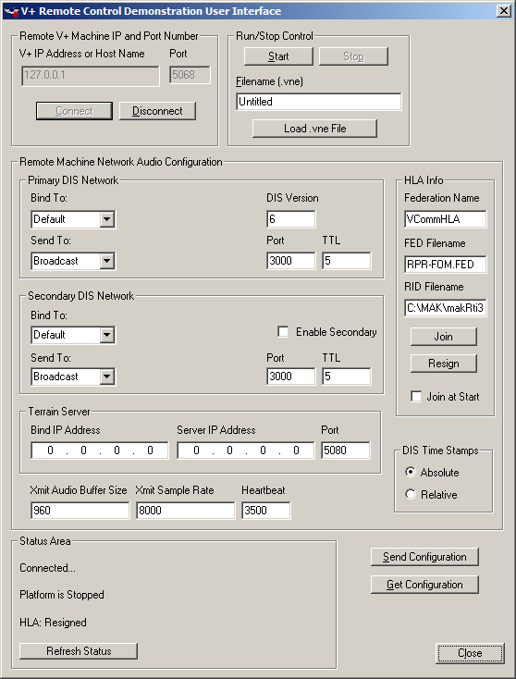
Programmatic Remote Control

Slide 76
Programmatic Remote Control
Host can start, stop and load designs.
Useful for automatic switching of V+ applications at run time by a host.
  Via TCP/IP, Port 5068

Slide 77
Miscellaneous Devices
(Section 5)

Slide 78
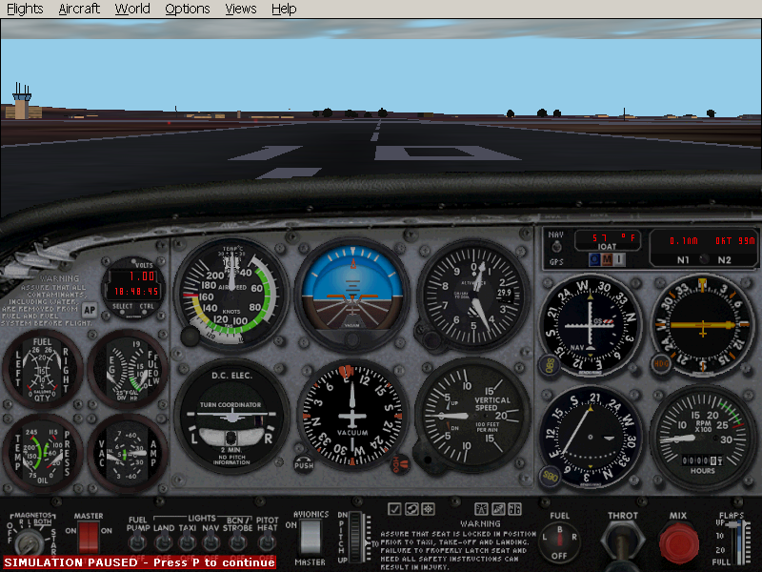
Microsoft Flight Simulator I/O Device
Read Virtually Any Data - From Game

Slide 79
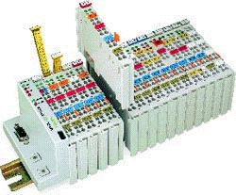
WAGO – PROFIBUS
Ethernet I/O Device
DIN Rail I/O Modules
  Choice of Ethernet
  or PROFIBUS
Excellent Transport Delay
  Distributed I/O

Slide 80
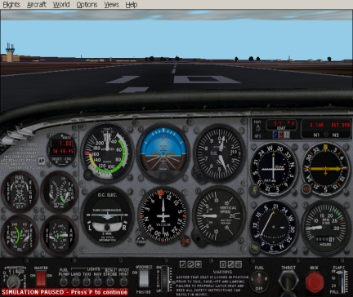
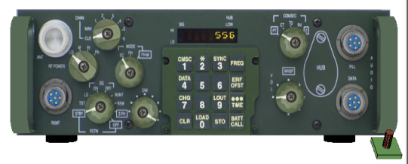

V+ the Tie That Binds
Your
Application
ATIS, VMIC, SCRAMNET, NATIONAL, etc…

Slide 81
Questions and Answers
(Section 6)

Slide 82
Q and A
Name the generations of programming paradigms.
Is V+ a code generator system?
What operating systems can host V+?
What type of visual language is V+?
  State Machine
  Object Oriented Nyquist
  Date Flow

Slide 83
Q and A
Data - contained in objects - only changeable by the developer, is called what?
What two types of pins can an object have in V+?
Objects that connect V+ data to the outside world, or to other software is called what?
Object pins are connected via what?

Slide 84
Closing Remarks
In the beginning there were computers, and the computer was programmed with ones and zeros.
The programmer said, let us use text for these codes so that we can understand them better. So the assembler was created and the programmer was happy.
Then the programmer said, let us program with words so that our programs are easier to understand. Hence, the compiler was born and the programmer smiled.
Then the engineer said let us use this machine and program it with drawings of our ideas. Thus, V+ was born, the engineer rested, and the programmer went home.

Slide 85

Any Questions?

